Slide 1
Coding Challenge
Team 13

Slide 2
Our Team & Roles
Irina Barzykina
Scrum Master, UX/UI design, frontend development
Raul Bocanu
Backend development & testing
Artem Tukhbatullin
Backend development & testing
Qiqi Zhou
Frontend development & testing

Slide 3
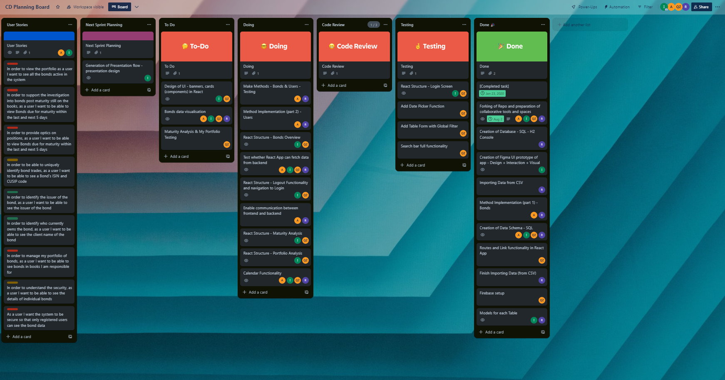
Agile Framework

Slide 4
Challenge
Creation of a diagnostics application for Operations in Fixed Income and Currencies, giving the ability to monitor inaccuracies in data and maturity of bonds in multiple trading books.

Slide 5
Stories Covered
MVP 1.0
1) Portfolio Overview
2,3) Maturity Analysis
4,8) Bond Details
5,6,7) Bond Ownership
9) Signup Features
MVP 2.0
1) Portfolio Overview
2,3) Maturity Analysis
4,8) Bond Details
5,6,7) Bond Ownership
9) Signup Features

Slide 6
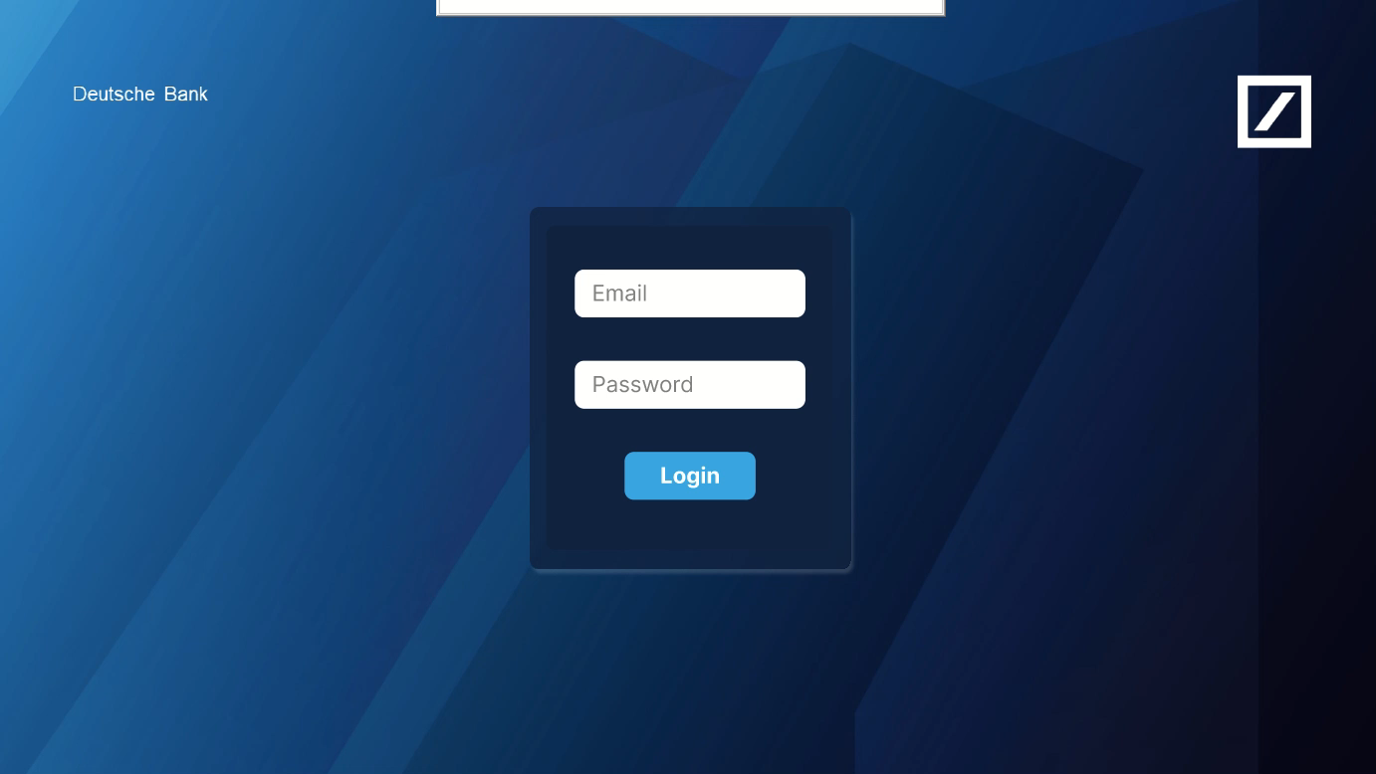
Technologies Used
Use of stack provided
MySQL
Springboot
React
JUnit
Mockito
Firebase
Figma UI Prototype of
application

Slide 7
Demo

